Slide 1
E6156 – Topics in SW Engineering: Cloud Computing
Lecture 8: CloudFront, Certificates, DNS, Service Composition, Step Functions
© Donald F. Ferguson, 2021

Slide 2

Will will start in a minute.
2 | E6156 – Topics in SW Engineering: Lecture 8: CloudFront, Certificates, Composition, Step Functions © Donald F. Ferguson, 2021

Slide 3
ETag, Conditional Update
3 | E6156 – Topics in SW Engineering: Lecture 8: CloudFront, Certificates, Composition, Step Functions © Donald F. Ferguson, 2021

Slide 4
REST and Isolation: Read then Update Conflict
Some
Resource
1. Bob GETs the resource.
3. Bob changes the data based on values.
2. Mary GETs the resource.
If
The written value
Depends on the read value.
The resource may be in the wrong state at the end.
The execution was RRWW
But the intent was RWRW.
4. Mary changes the data based on values.

Slide 5
Isolation/Concurrency Control
This requires conversation state, which would violate the REST Stateless principle.
There are two basic approaches to implementing isolation
Locking/Pessimistic, e.g. cursor isolation
Optimistic: Before committing, each transaction verifies that no other transaction has modified the data it has read.
How does this work in REST?
The server maintains an ETag (Entity Tag) for each resource.
Every time a resource’s state changes, the server computes a new ETag.
The server includes the ETag in the header when returning data to the client.
The server may optionally maintain and return “Last Modified” time for resources.
Semantics on updates
If-Match – value of a previous calls ETag response used with a PUT or DELETE. Server should only act if nobody else has modified the resource since you last fetched it. Otherwise provides a 412.
If-Modified-Since – value of a previous Last-Modified response used with a GET. Server should only provide a response if the resource was modified since the timestamp submitted. Use in conjunction with If-None-Match in case the change occurred within the same second. Otherwise provide a 304.
If-None-Match – value of a previous calls ETag response used with a GET. Server should only provide a response if the ETag doesn’t match, i.e. the resource has been altered. Otherwise provide a 304.
If-Unmodified-Since – value of a previous Last-Modified response used with a PUT or DELETE. Server should only act if nobody else has modified the resource since you last fetched it. Otherwise provides a 412

Slide 6
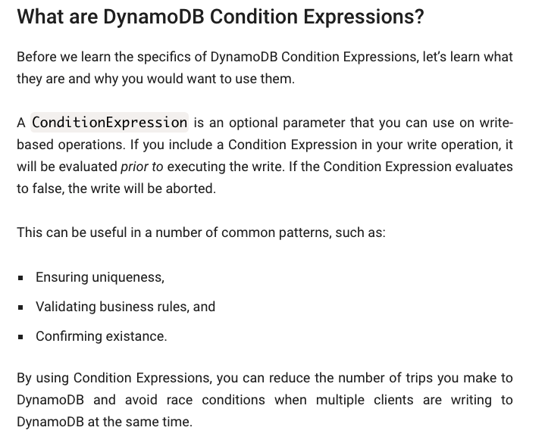
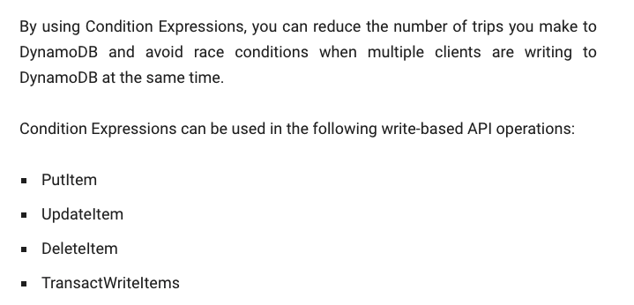
Conditional Operations

Slide 7
Hands-On CloudFront DNS, Certificate, HTTPS
7 | E6156 – Topics in SW Engineering: Lecture 8: CloudFront, Certificates, Composition, Step Functions © Donald F. Ferguson, 2021

Slide 8
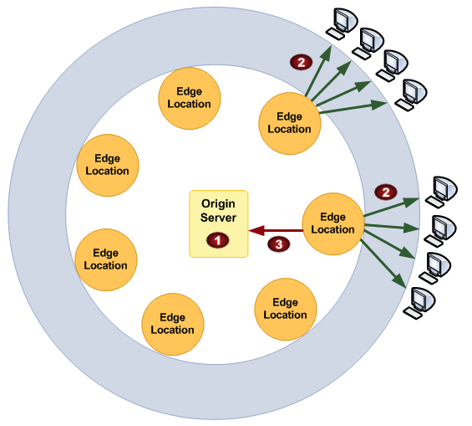
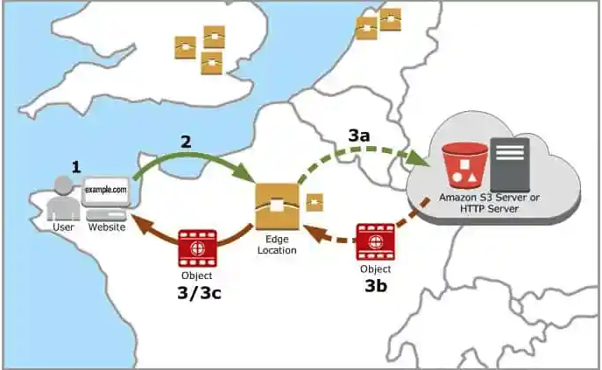
CloudFront
“A content delivery network, or content distribution network (CDN), is a geographically distributed network of proxy servers and their data centers. The goal is to provide high availability and performance by distributing the service spatially relative to end users.” (https://en.wikipedia.org/wiki/Content_delivery_network)

Slide 9
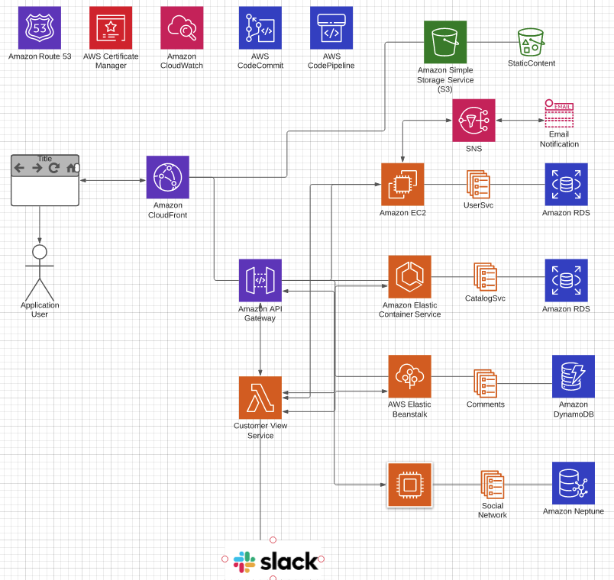
Overall Architecture
There may be multiple
Microservices
Web UI projects/content
CloudFront
Multiple S3 content → one site.
Forward API requests to API GW
API GW manages/monitors APIs
Networking/HTTPS requires
Domain, DNS
Certificates

Slide 10
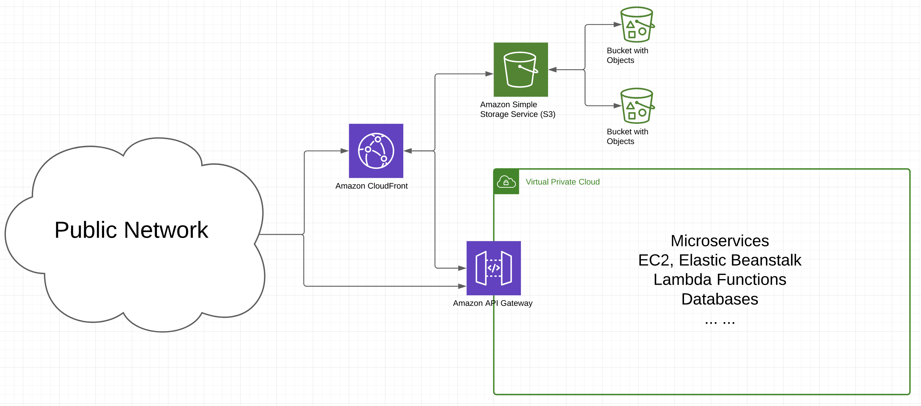
Big Picture

Slide 11
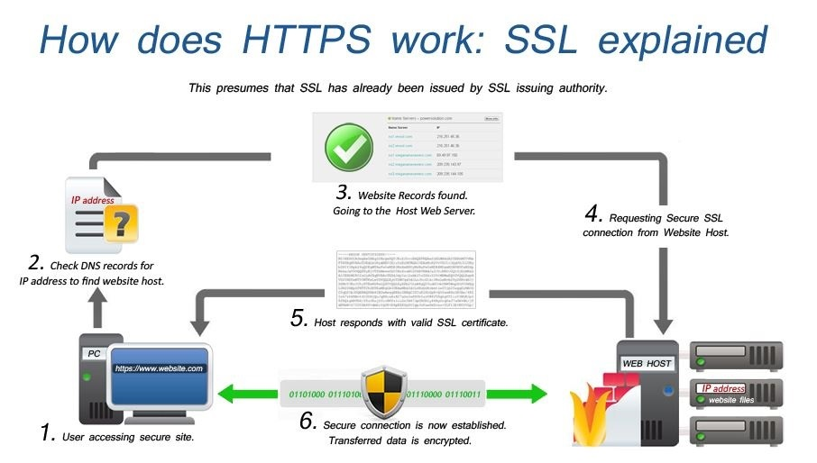
Certificates and HTTPS

Slide 12
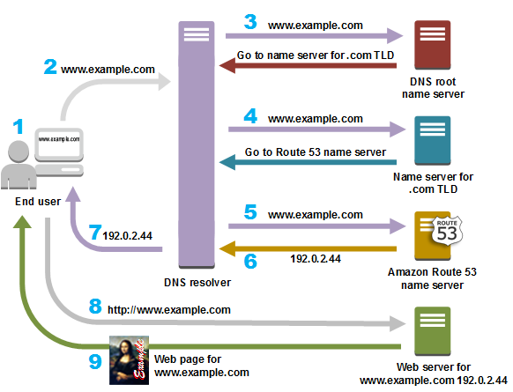
DNS

Slide 13
Things to Demo
CloudFront:
Distributions, Origins, Behavior
Monitoring, caching, alarms, ... ...
Certificates
AWS implementation
Use in CloudFront and elsewhere
Visibility in browser, HTTPs
Route 53
Proving ownership
Records

Slide 14
Service Composition
14 | E6156 – Topics in SW Engineering: Lecture 8: CloudFront, Certificates, Composition, Step Functions © Donald F. Ferguson, 2021

Slide 15
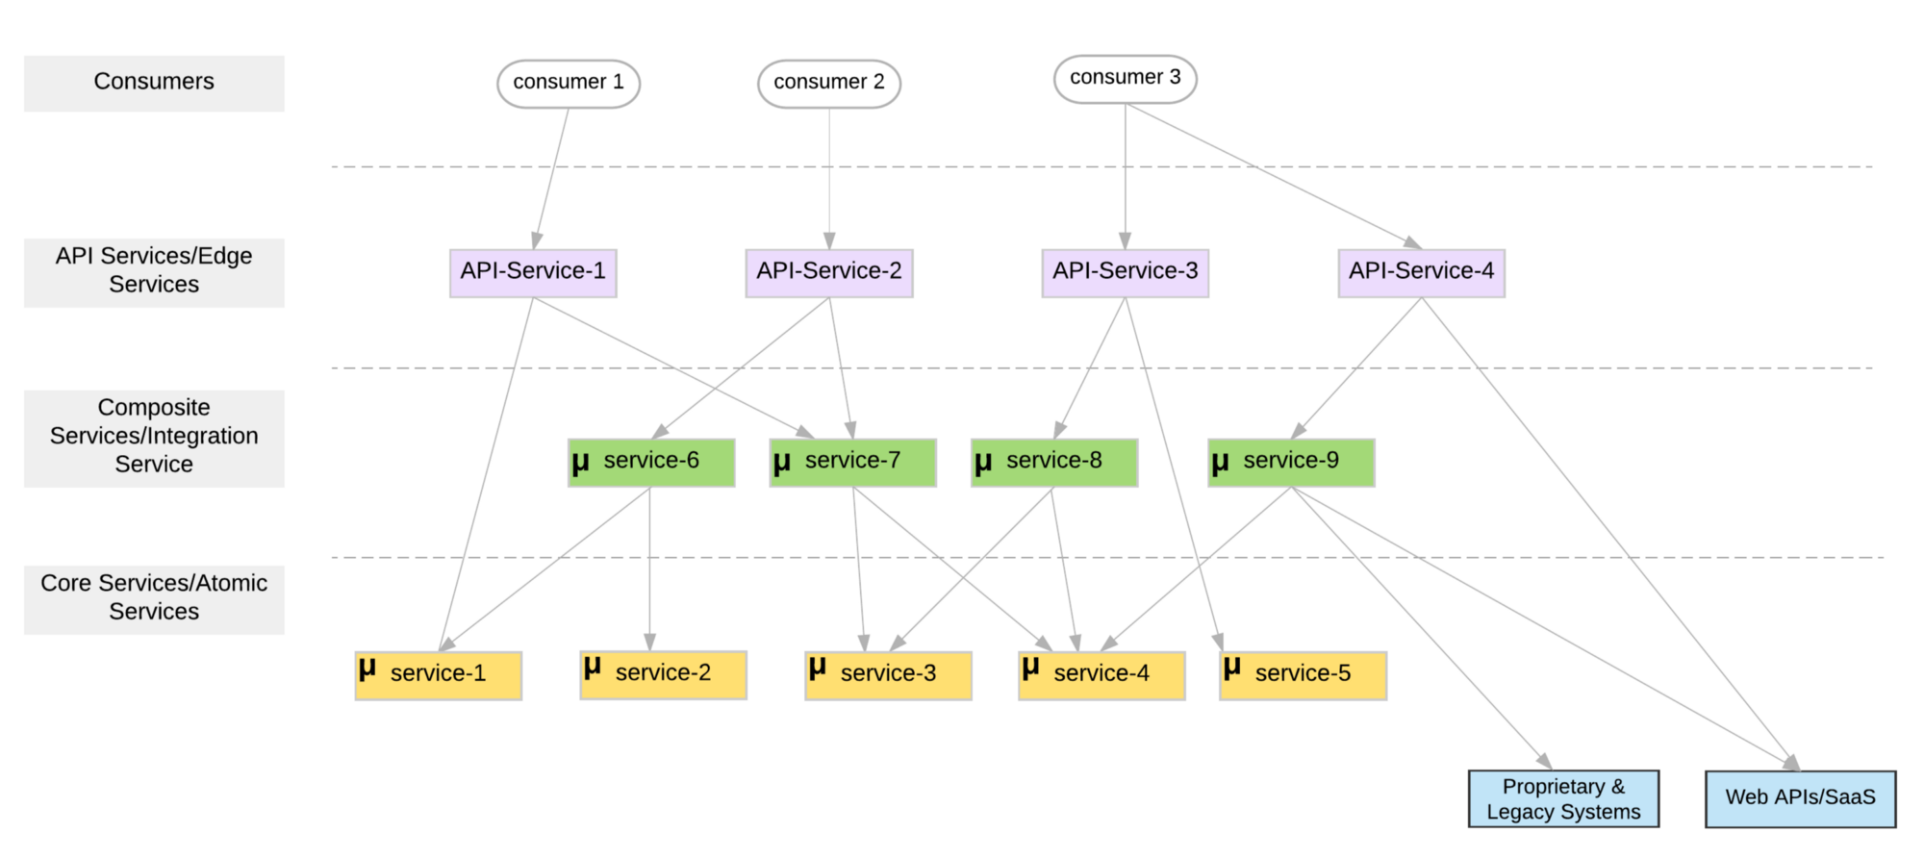
Microservice Layers

Slide 16
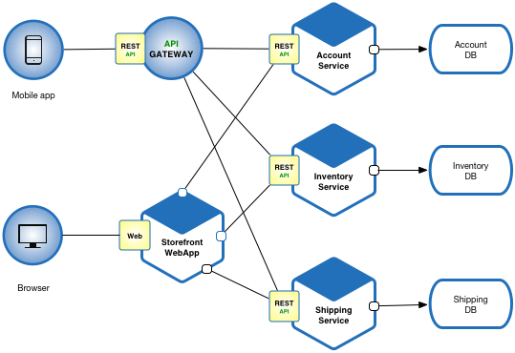
Another View

Slide 17
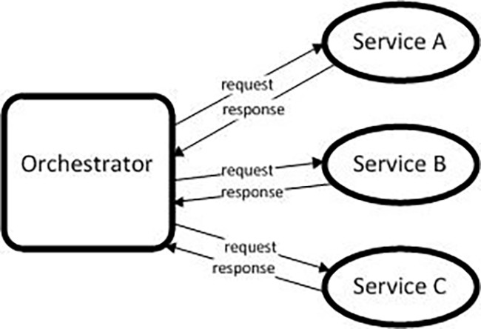
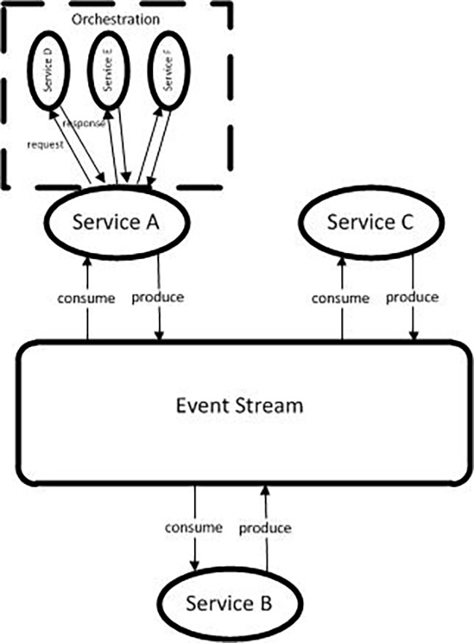
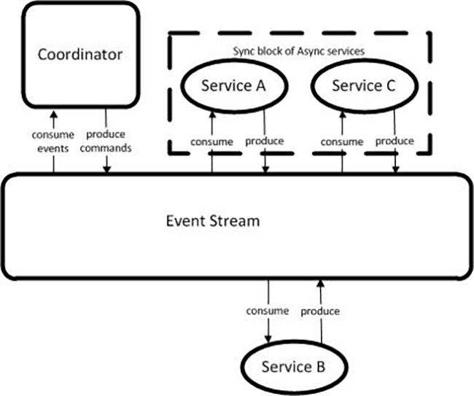
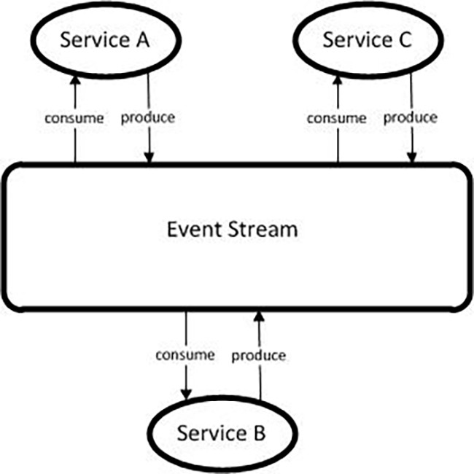
Models (https://medium.com/capital-one-tech/microservices-when-to-react-vs-orchestrate-c6b18308a14c)

Slide 18
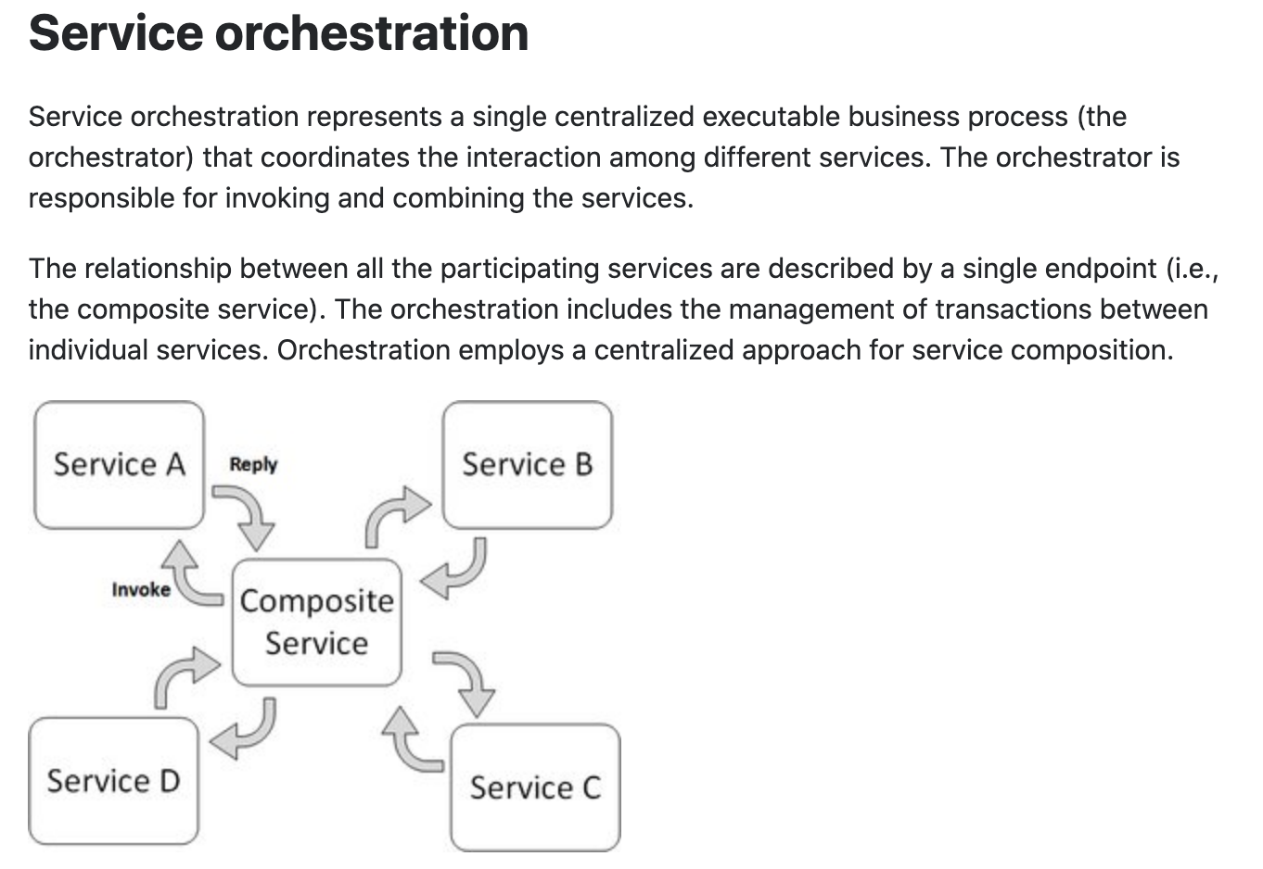
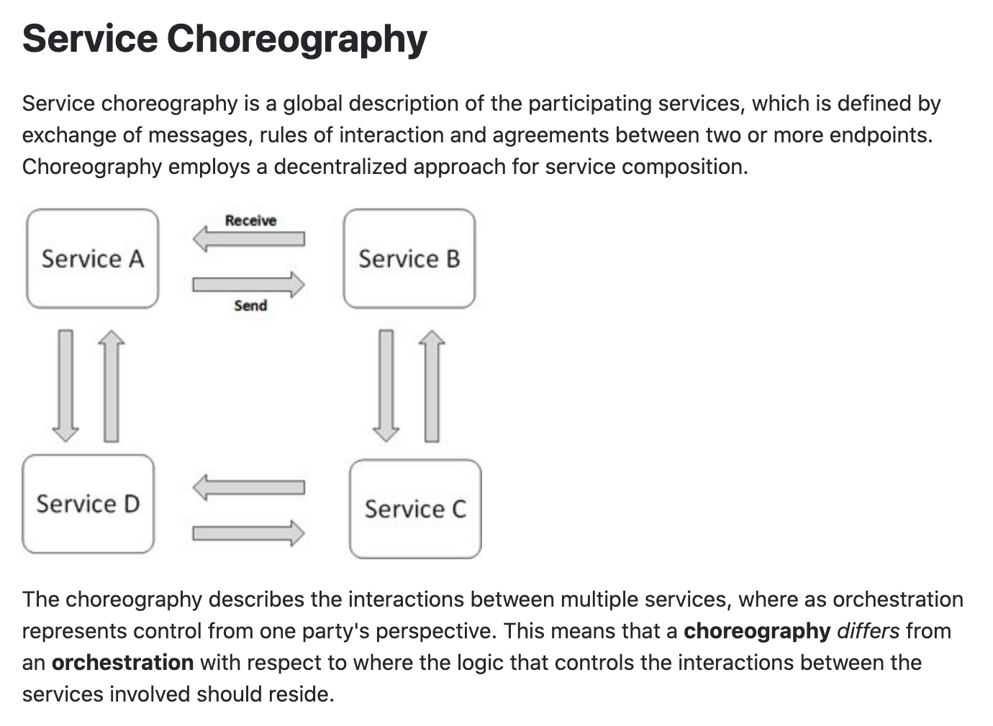
Concepts
These are not formally, rigorously defined terms.

Slide 19
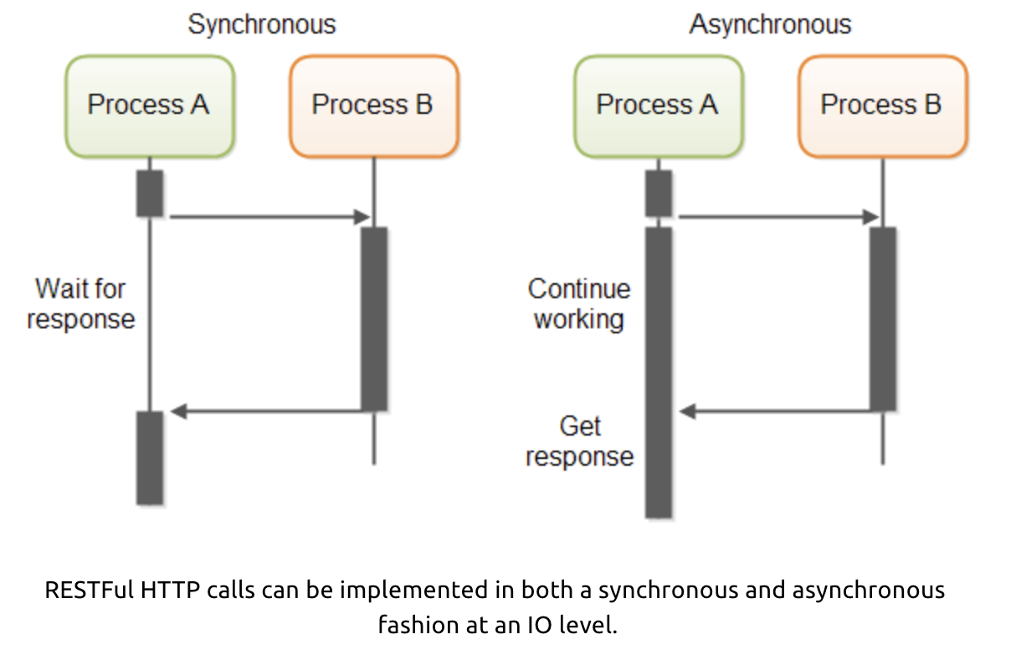
Service Orchestration/Composition
One call to a composite service
May drive calls to multiple other services.
Which in turn, may drive multiple calls to other services.
Synchronous (Wait) and calling one at a time, in order is
Inefficient
Fragile
... ...
Asynchronous has benefits but can result in complex code.

Slide 20
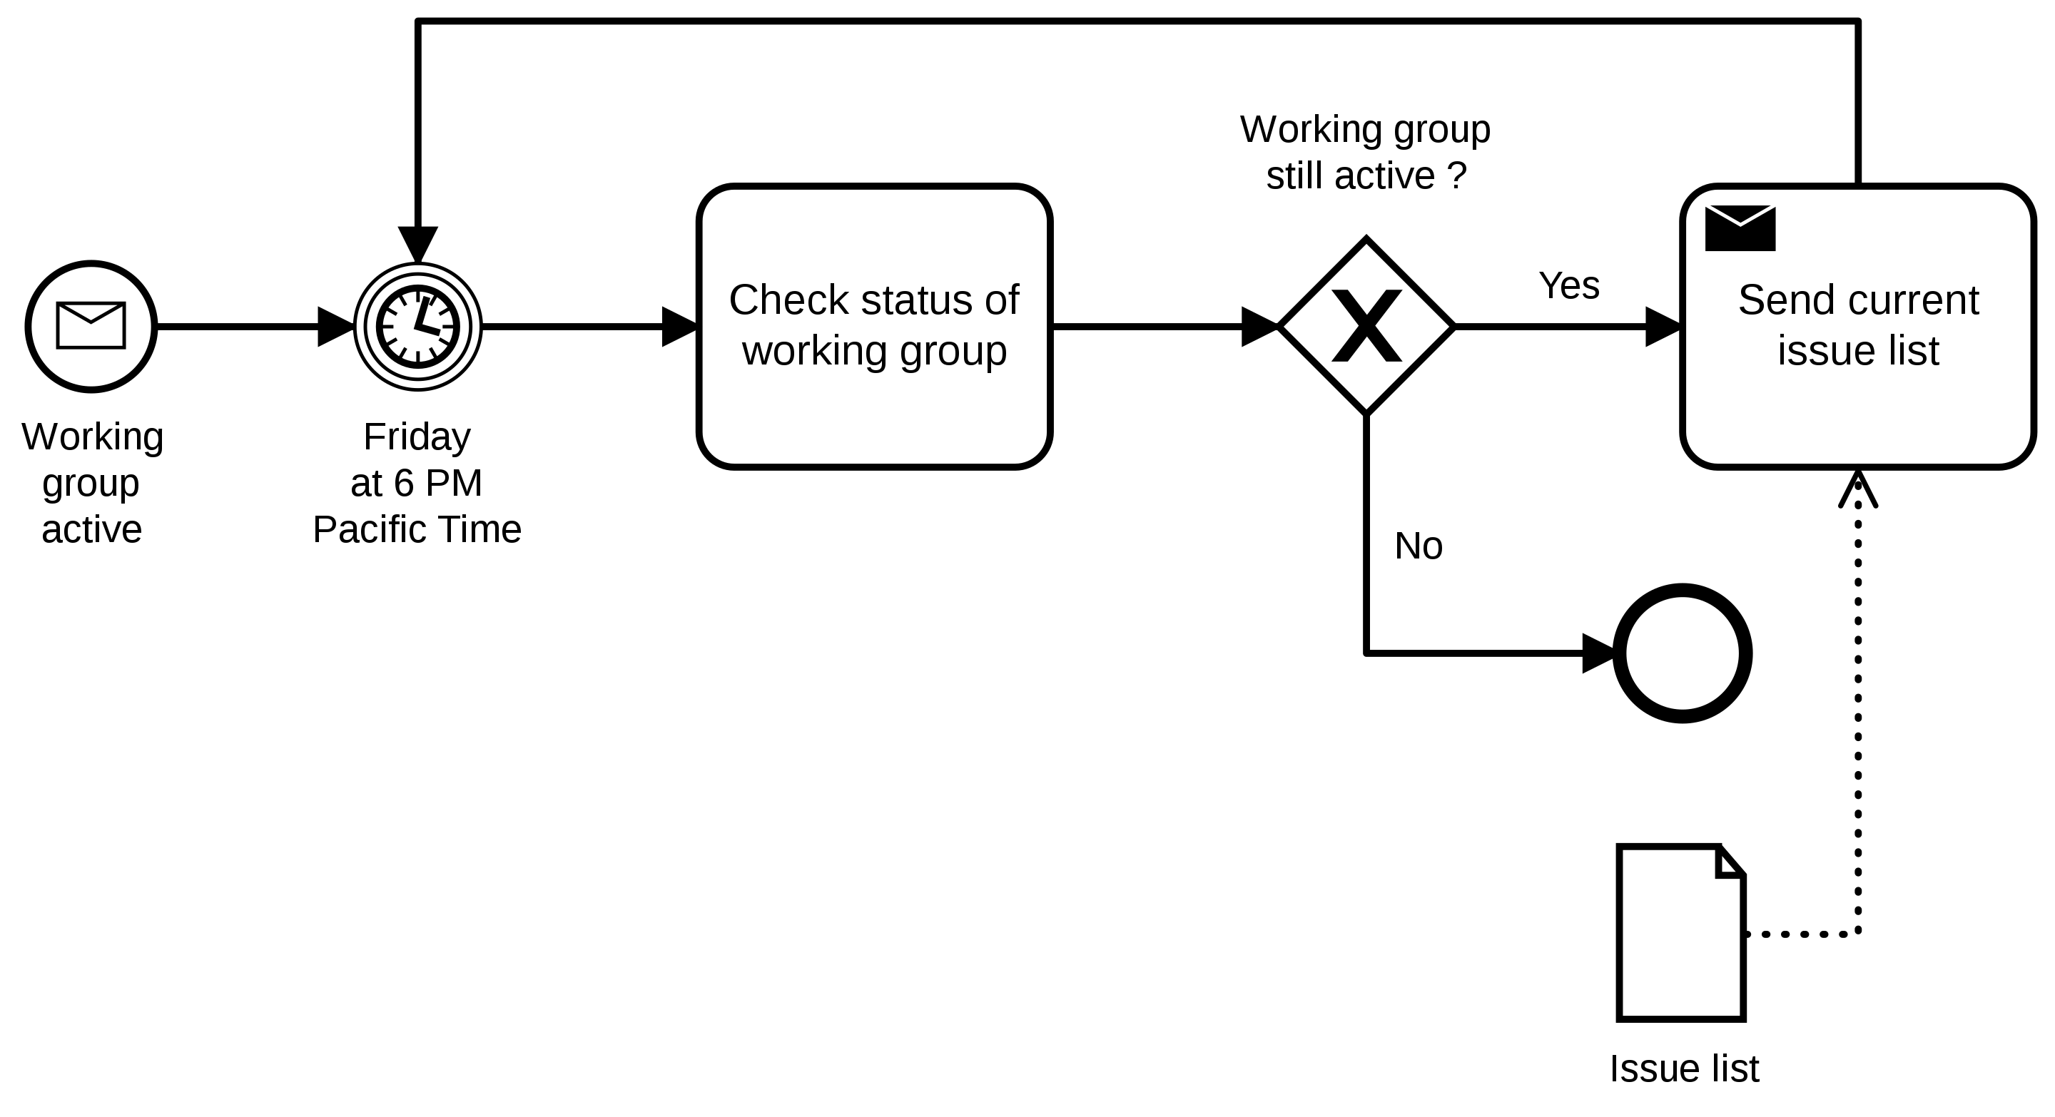
BPMN
Business Process Model and Notation (BPMN) is a graphical representation for specifying business processes in a business process model.
(https://en.wikipedia.org/wiki/Business_Process_Model_and_Notation)

Slide 21
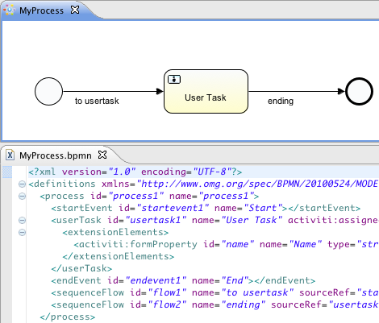
Executable Workflow Models
The modeler is a visual editor for the underlying language.
The “engine” can interpret the “program” to perform long running, asynchronous orchestration.

Slide 22
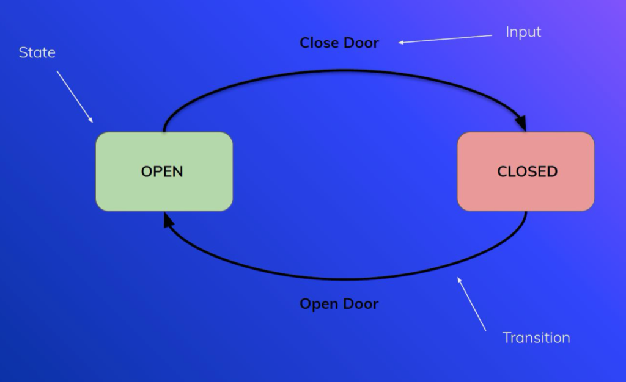
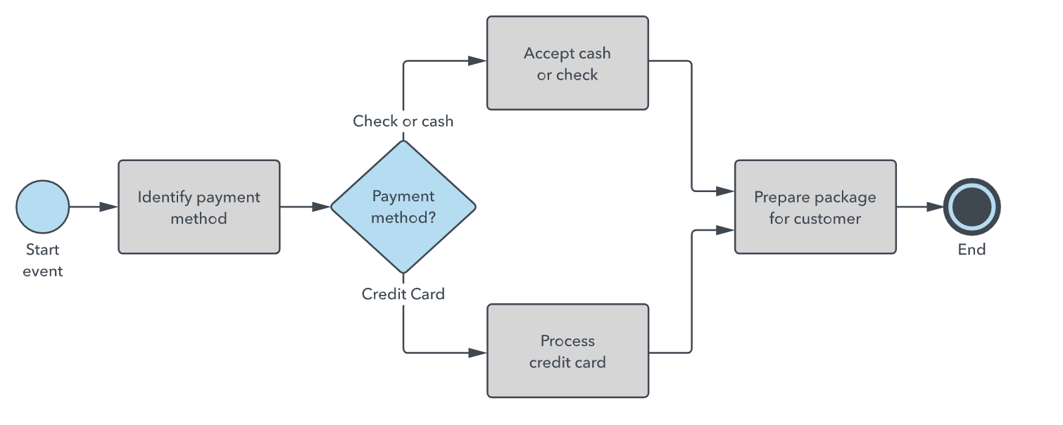
Two Core Models: State Machine, Control Graph
The two models/approaches are equivalent.
Workflow (BPMN) represents control flow, decisions, ... ... The state is:
The current active tasks.
The working memory of documents sent and receive.
There is a clear concept of “next tasks.”
State machine has the concepts of (state, enabled events, action, next state).

Slide 23
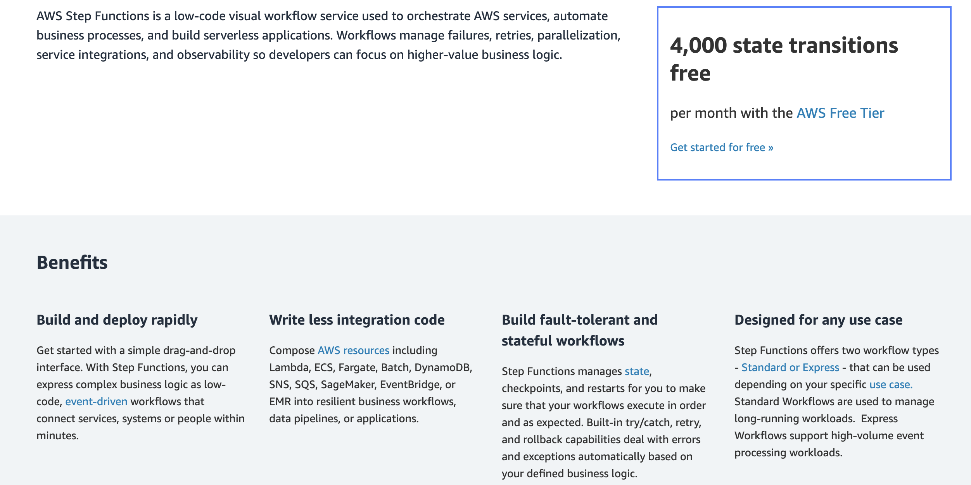
AWS Step Functions

Slide 24
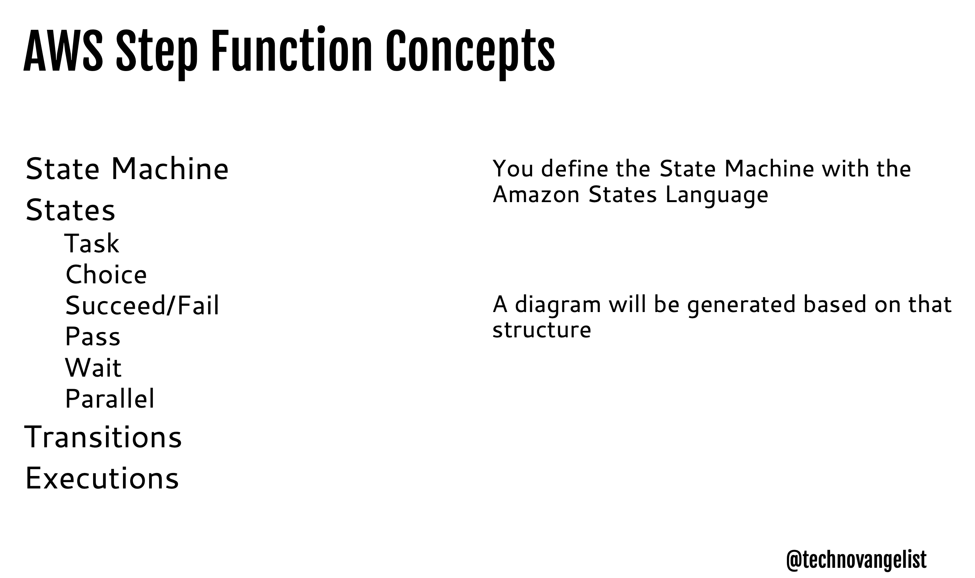
Step Functions

Slide 25
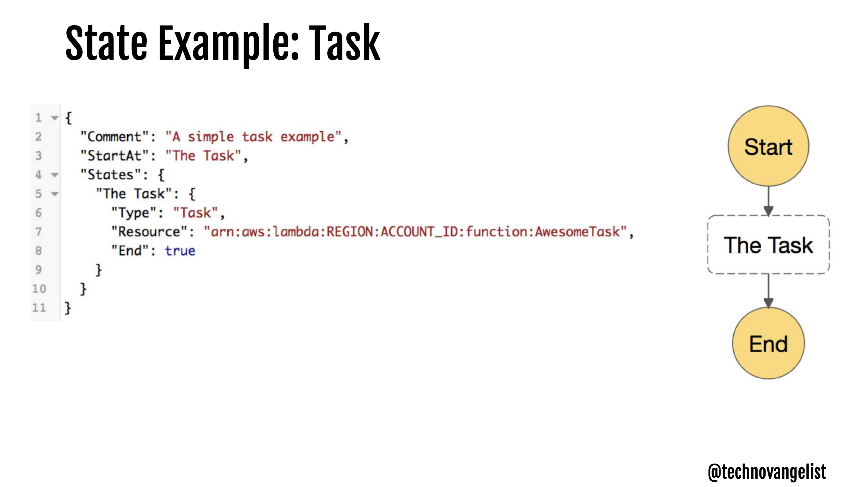
Step Functions

Slide 26
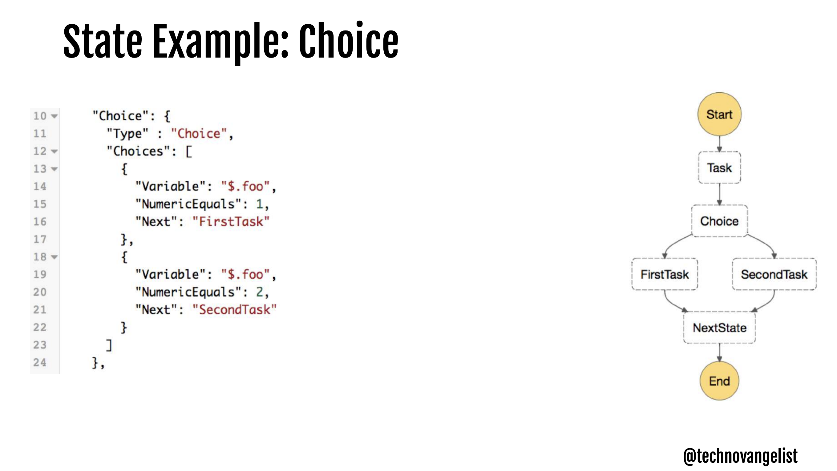
Step Functions

Slide 27
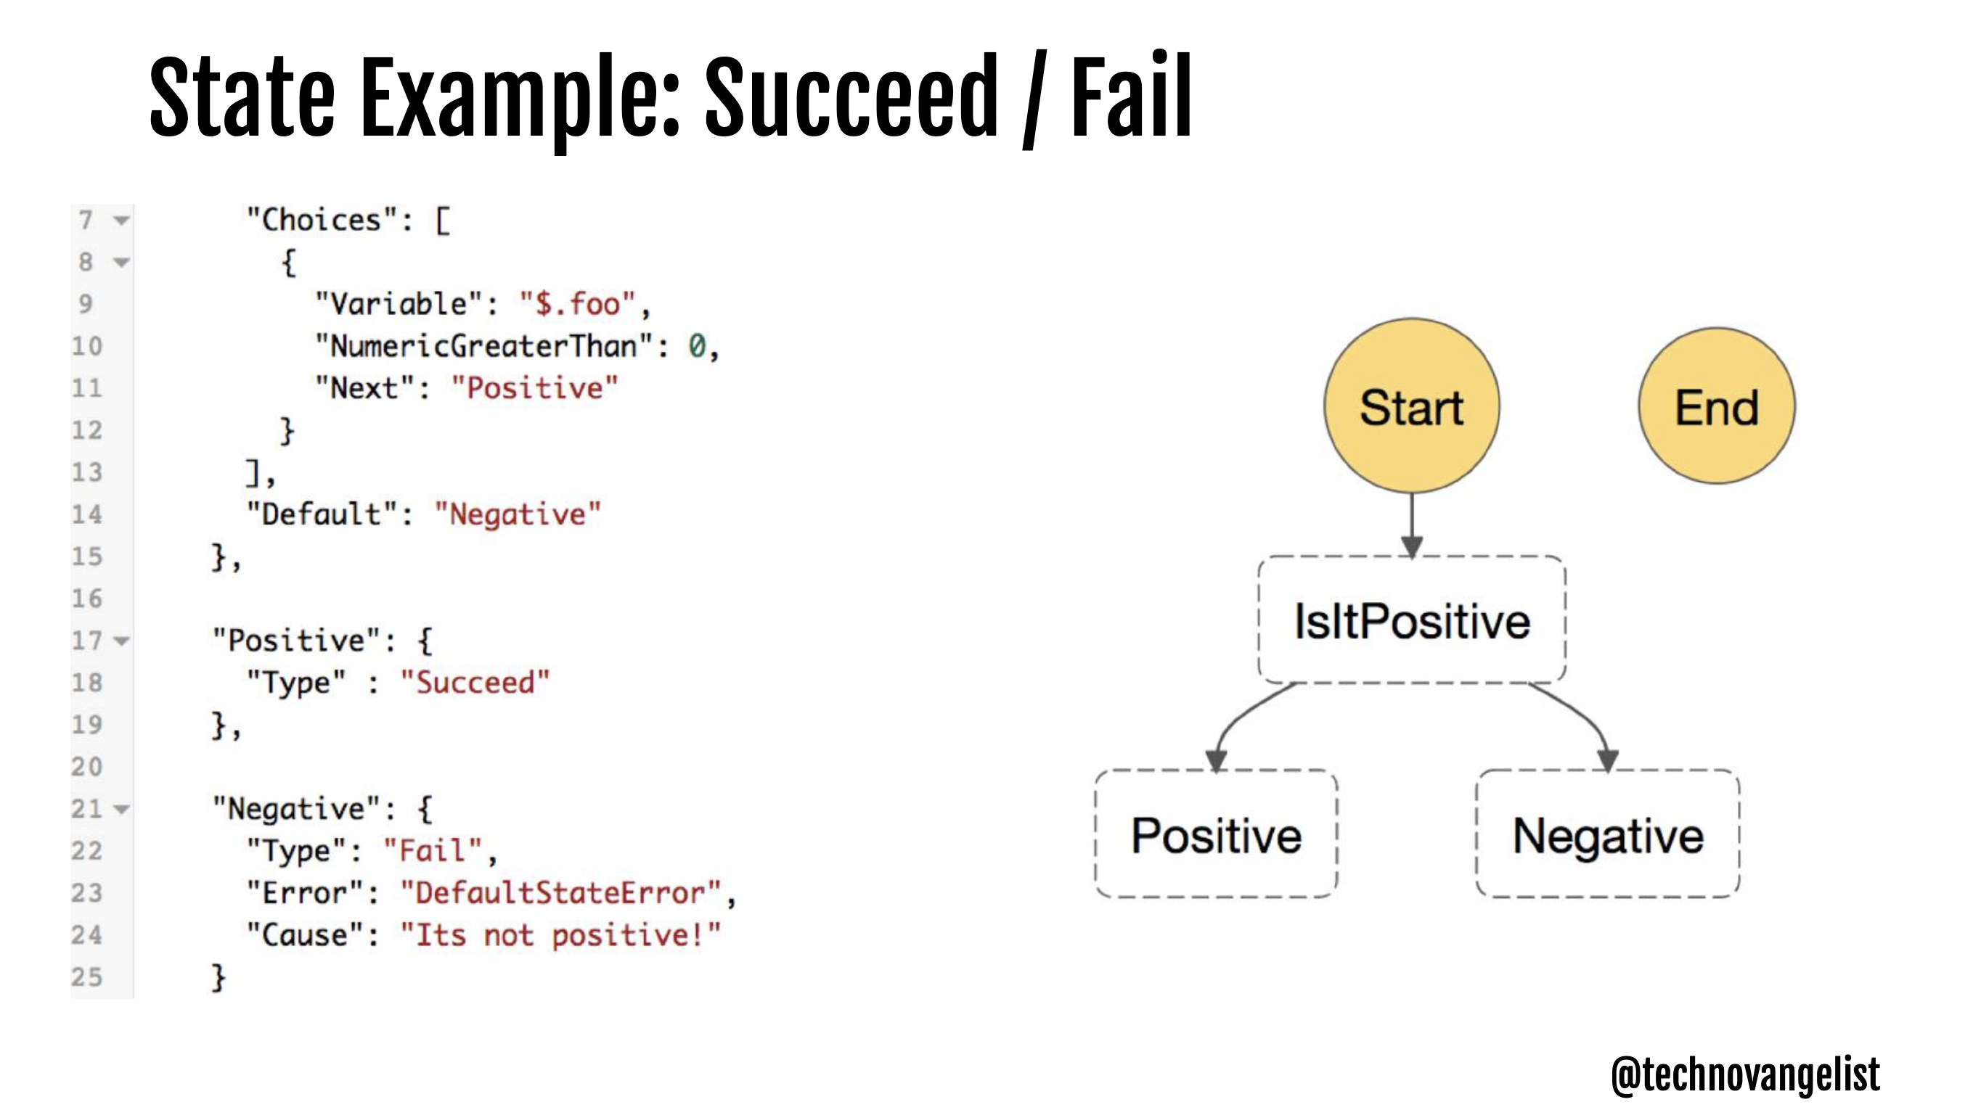
Step Functions

Slide 28
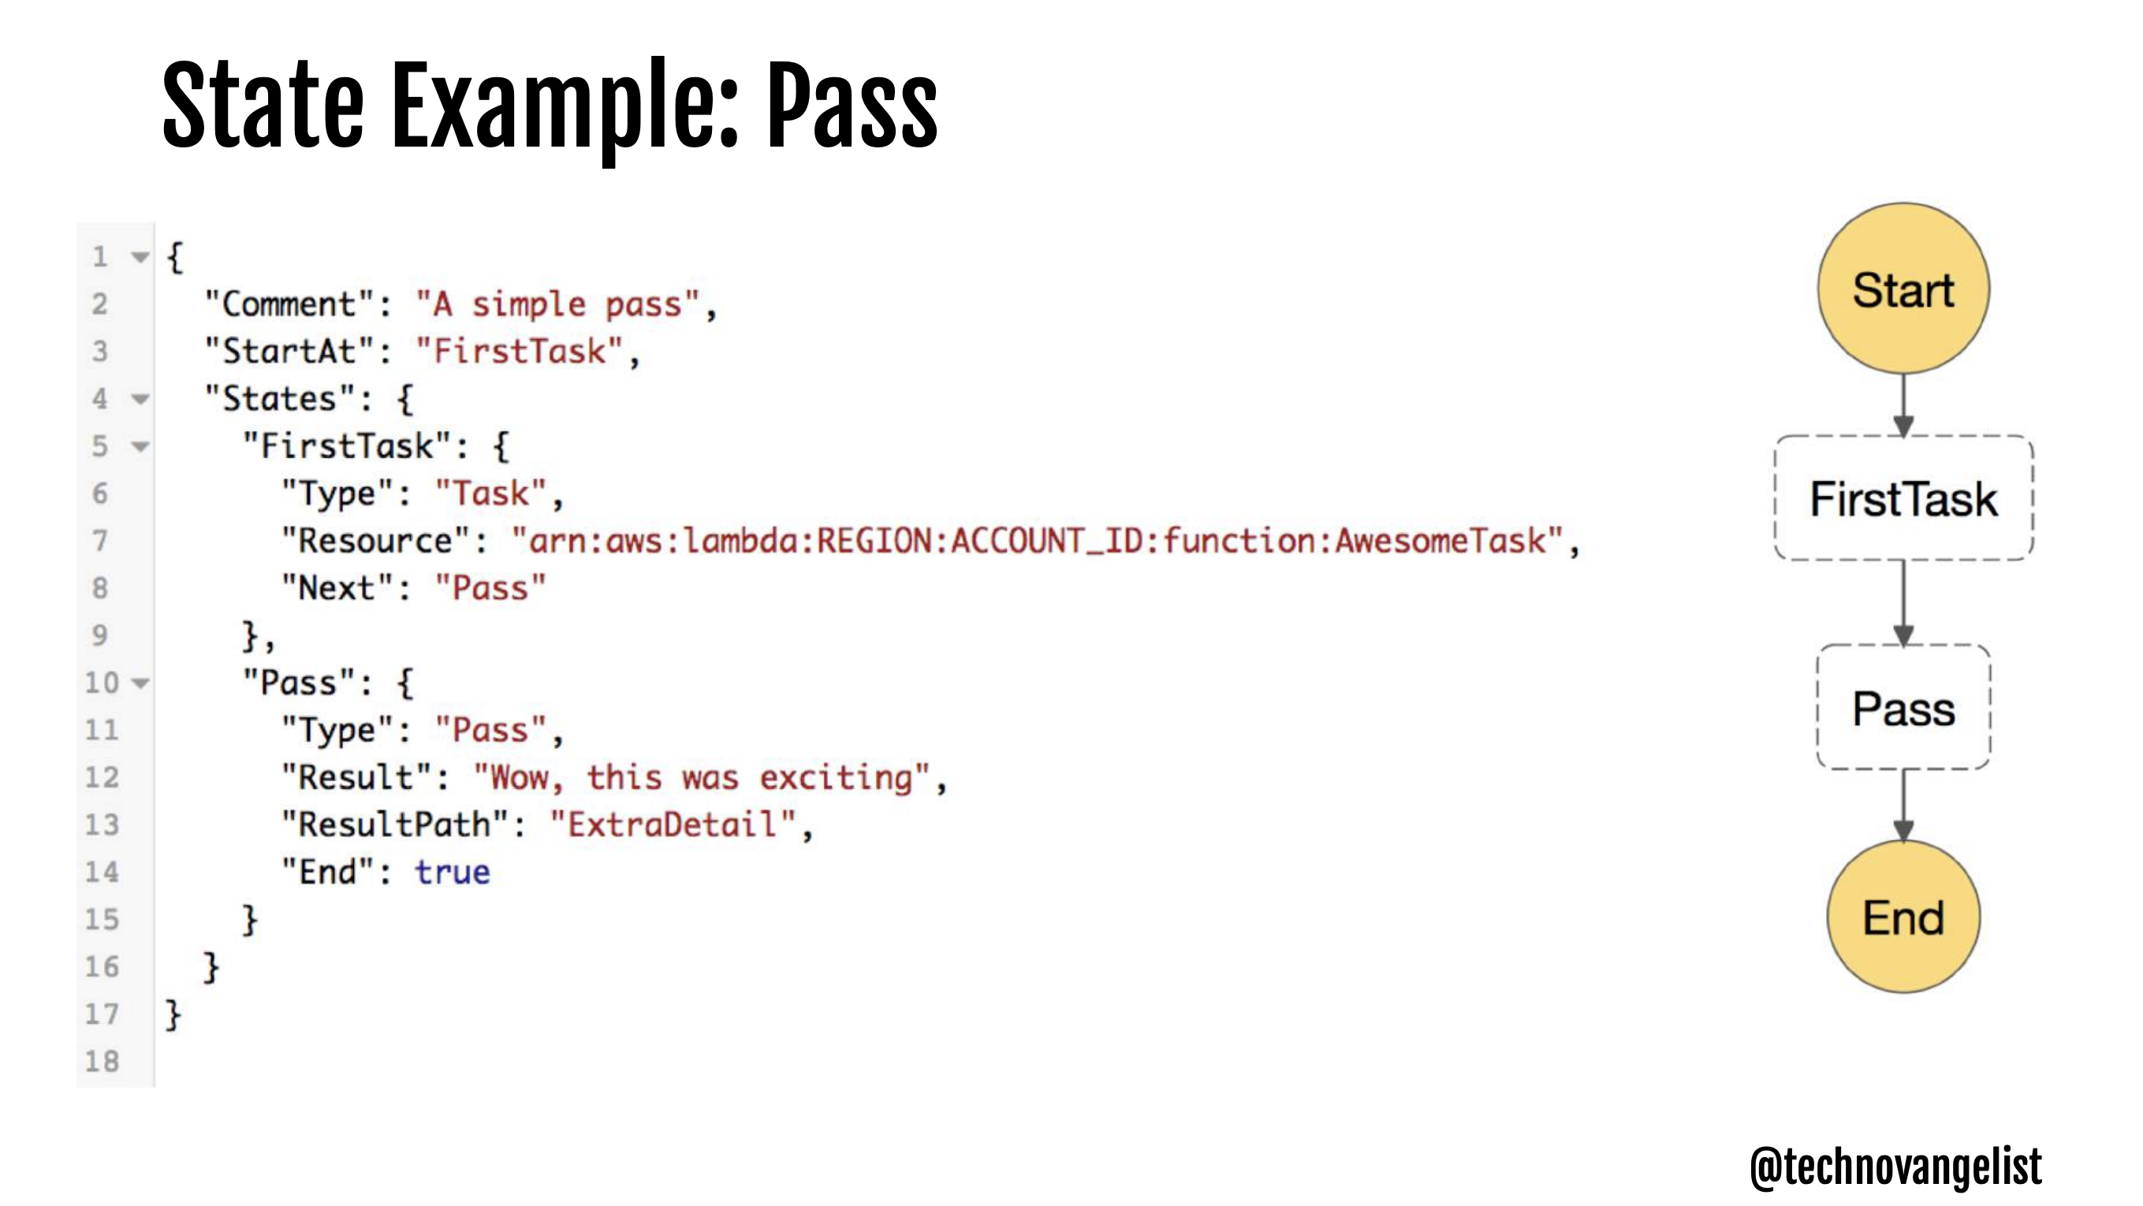
Step Functions

Slide 29
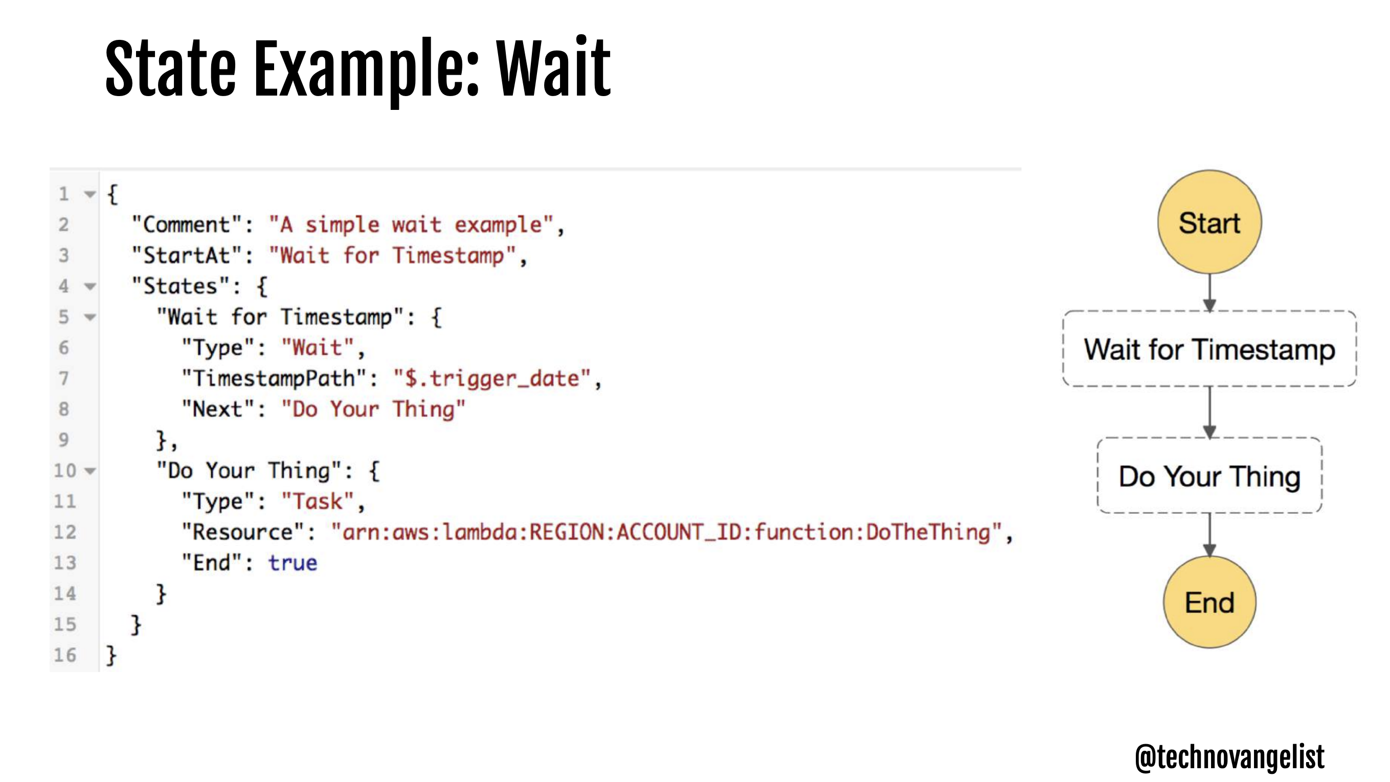
Step Functions

Slide 30
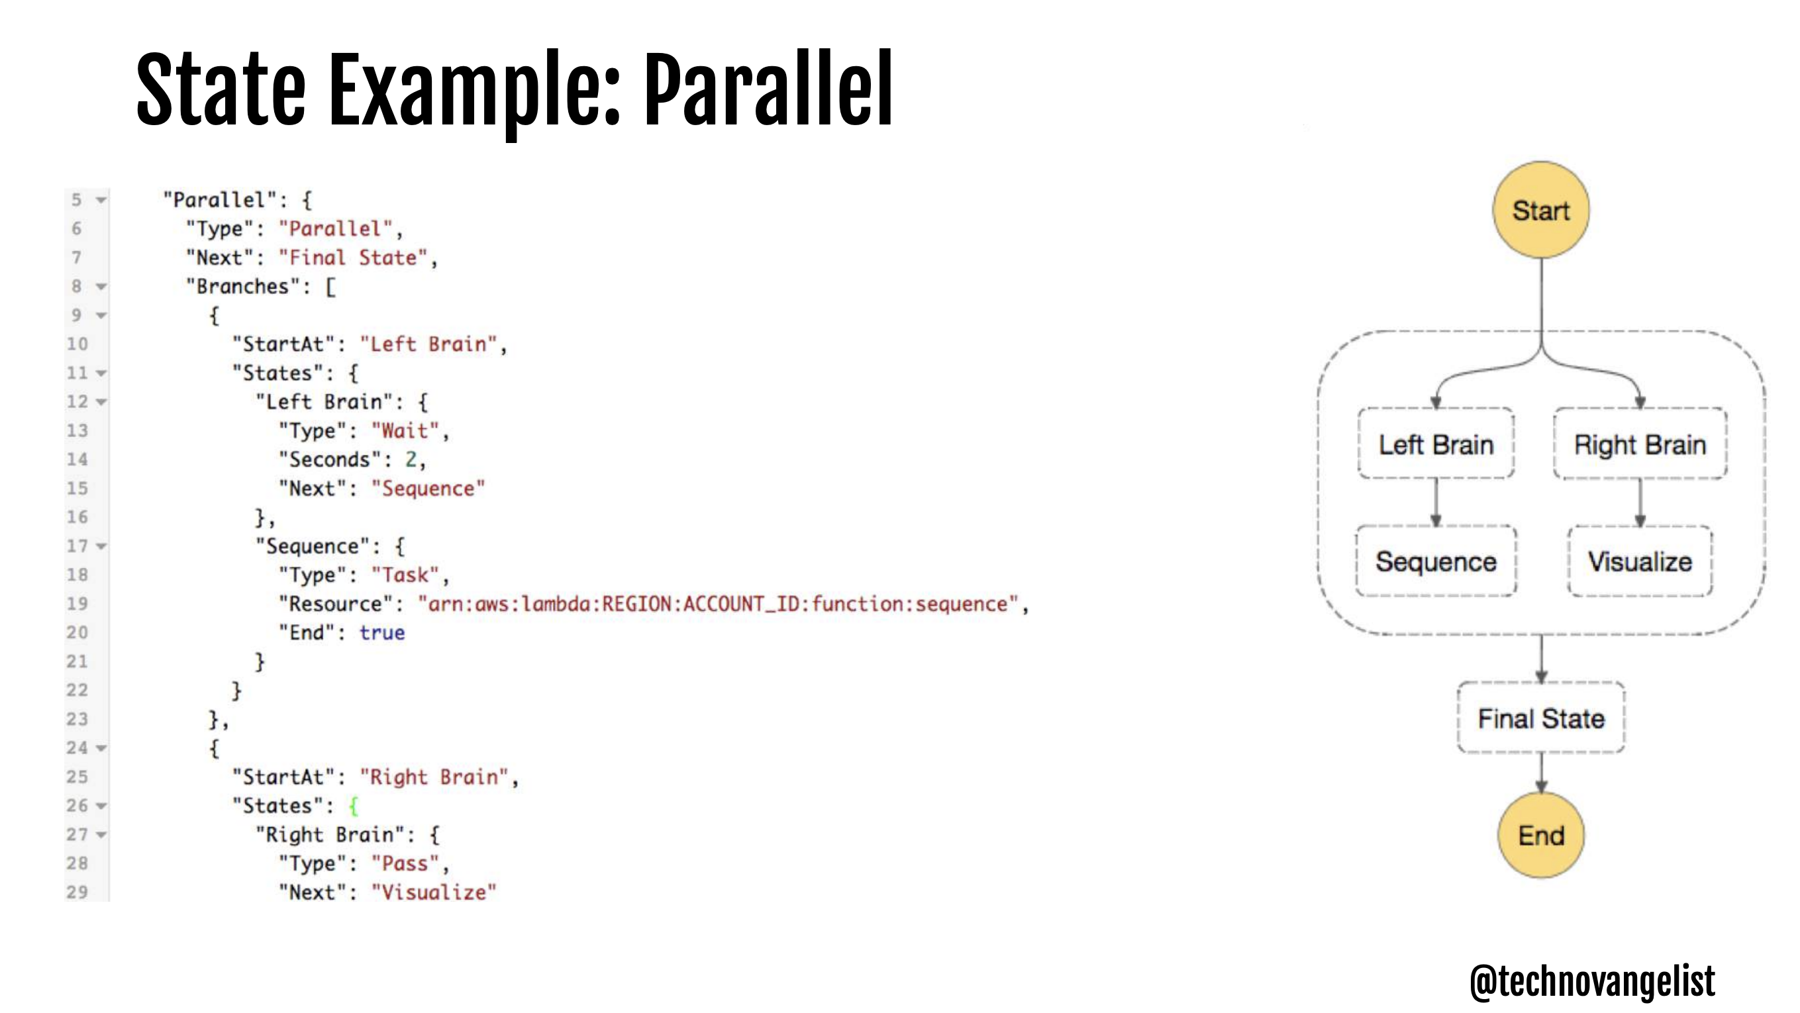
Step Functions

Slide 31
Next Steps
Flesh out and expand
CloudFront
S3 static content
API gateway
Microservices
Develop composite microservices and get a feel for the patterns
Step Functions
Asynchronous Call-Return
Event Driven
I will provide some examples and you must adapt to your project.

